Slide 1
In Vehicle Networking Project
Fleet Tracking and Monitoring System
Team ProtoCAN
Presented By:
Abishek R – 22MES0011
Ezhil Subbia K – 22MES0006
Kevin Abishek S – 22MES0041
Aadhitya S V – 22MES0007
Ashwin Hariharan R – 22MES0025

Slide 2
Features Planned
Uses GPS tracking to monitor the activity of fleet vehicles and assets.
Reliable and scalable data collection for vehicle trackers and embedded sensors.
Advanced and flexible IoT data visualization for both real-time and historical vehicle data.
Customizable end-user dashboards to share data from the vehicle tracking system with end users and customers
Driver driving patterns monitoring – sudden acceleration, deceleration, braking, etc.
Monitoring of critical payload environment – temperature, pressure, humidity, etc

Slide 3
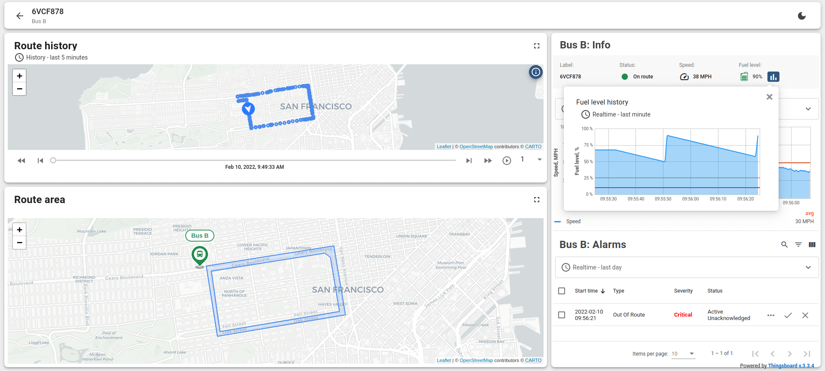
Dashboard

Slide 4
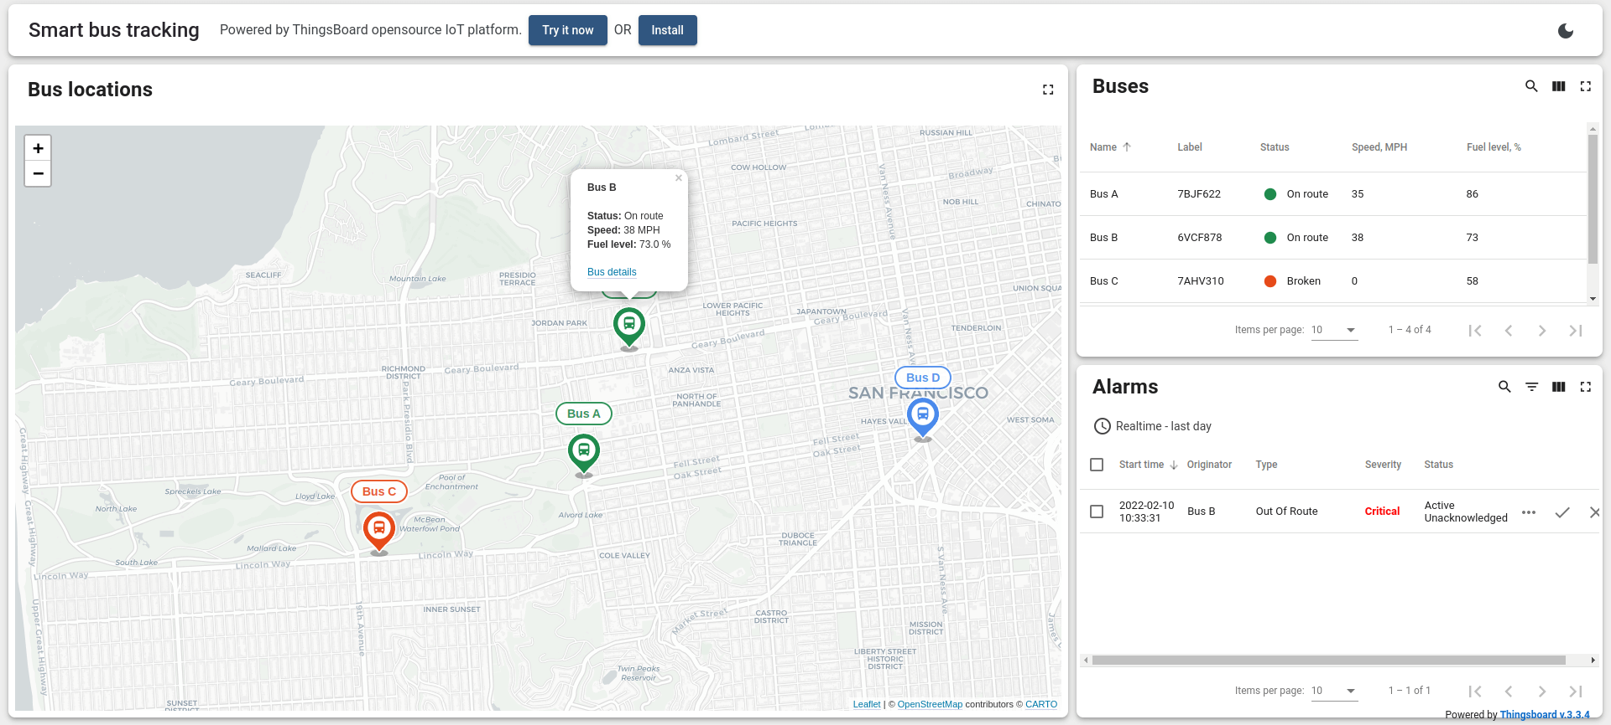
Dashboard

Slide 5
Block Diagram
GPS
Microcontroller 2
CAN controller 2
Microcontroller 1 with inbuilt BLE or RF
CAN controller 1
CAN controller 4
Microcontroller 4
CAN controller 3
GSM/ Wi-Fi/ IoT sim
HTTP/MQTT
BLE or RF
IoT Server
Microcontroller 3
HTTP
Tyre pressure sensor
Web Dashboard
IMU
Temperature Sensor
Humidity Sensor
Barometer

Slide 6
Connection Establishment
We have built a prototype in which we established CAN Bus communication between two microcontrollers to send temperature and humidity data taken using a sensor. This was done using a CAN controller with an inbuilt CAN transceiver from Microchip.

Slide 7
Features of CAN Controller Used
Inbuilt High-speed CAN transceiver
8MHZ crystal oscillator
SPI control for expandable Multi CAN bus interface
Supports 1 Mb/s CAN operation
Uses CAN2.0B
120Ω terminal resistance
Low current standby operation
Up to 112 nodes can be connected

Slide 8
Block diagram with no inbuilt CAN controller
Transmitter Receiver
Sensor
Tested Architecture
Xtensa – MIPS (32 bit)
STM – ARM (32 bit)
AVR (8/16 bit)
Serial Monitor
One-Wire
RX
TX
UART
Microcontroller
SPI Master
Microcontroller
SPI Master
500 Kbits/sec
MISO
CLK
SS
(0v-3.3v/0v-5v)
(0v-3.3v/0v-5v)
MISO
CLK
SS
500 Kbits/sec
MOSI
MOSI
CAN
Controller
SPI Slave
CAN
Controller
SPI Slave
CAN TX
CAN bus to TTL
(0v-3.3v/0v-5v)
(0v-3.3v/0v-5v)
CAN bus to TTL
CAN RX
CAN_H Bus
CAN Transceiver
CAN Transceiver
CAN_L Bus

Slide 9

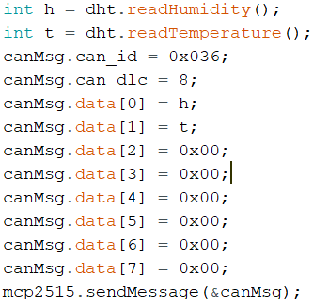
CAN Transmitter
The bit rate is set at 500Kbps and clock frequency at 8MHz.
Humidity(h) and Temperature(t) values are obtained from the sensor.
Data length Code(DLC )is set to 8 and we gave the h and t data to the data[0] and data[1] and rest all data with 0 and transmitted over the bus.

Slide 10

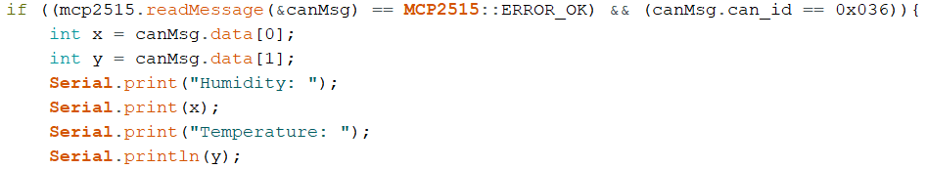
CAN Receiver
The CAN Receiver receives the Temperature and Humidity data from CAN bus.
The CAN receiver is set at 500Kbps and a clock frequency of 8MHz .
The received data is displayed through serial monitor.

Slide 11
Block diagram with built-in CAN controller
Planning to test
Xtensa – MIPS (32 bit)
STM – ARM (32 bit)
Transmitter Receiver
Sensor
Serial Monitor
One-Wire
RX
TX
UART
Microcontroller with CAN controller
Microcontroller with CAN controller
CAN TX
CAN bus to TTL
(0v-3.3v/0v-5v)
(0v-3.3v/0v-5v)
CAN bus to TTL
CAN RX
CAN_H Bus
CAN Transceiver
CAN Transceiver
CAN_L Bus

Slide 12
Features of CAN Transceiver
Onboard TJA1050 CAN controller interface chip
5V power supply
High speed (up to 1 Mbaud)
Differential receiver with wide common-mode range for high Electro-Magnetic Immunity (EMI)
An unpowered node does not disturb the bus lines
Input levels compatible with 3.3 V and 5 V devices

Slide 13
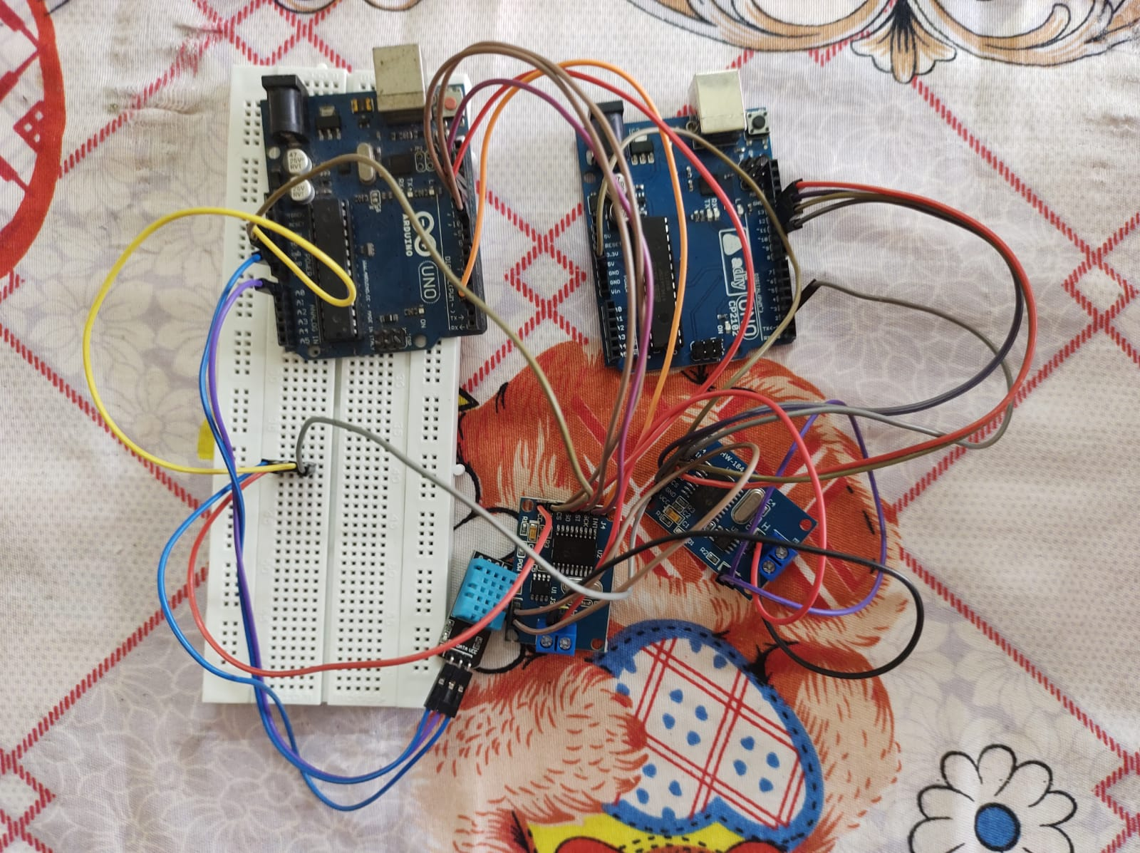
Hardware

Slide 14
Thank You

